Slide 1
User design
NeedFINDING
Target audience: lunch go-ers (students)
Maga, katrina kin
Lapuz, Karlvin

Slide 2
Questions:
What are your thoughts on the allotted time for lunch breaks, is it enough?
How do you spend your breaks?
Are the food choices on the cafeteria enough?
How about the food line queuing?
What are the reasons for you not to eat at the cafeteria, and where do you usually eat out?

Slide 3
Interviewee: Yukimura Rin Age: 19
What are your thoughts on the allotted time for lunch breaks, is it enough?
It's enough to eat and chill with friends.
How do you spend your breaks?
I spend it bugging my friends.
Are the food choices on the cafeteria enough?
They're enough
How about the food line queuing?
The queue can be too annoying. hopefully APC changes or adjusts some courses and sections time for lunch.

Slide 4
Interviewee: Conway Frost Age: 19
What are your thoughts on the allotted time for lunch breaks, is it enough?
My thoughts on the time given for lunch doesn't help considering that the cafeteria becomes full and hard to find tables to eat at and really long lines as well as it doesn't give enough time to eat outside. If you are able to wait till the crowd in the cafeteria decreases it doesn't give enough time to sit down and eat because you only have a few minutes.
How do you spend your breaks?
Getting a few minutes of rest in the library then going to get lunch in the cafeteria.
Are the food choices on the cafeteria enough?
The food choices are plenty.

Slide 5
Interviewee: Conway Frost Age: 19
How about the food line queuing?
The line queues are very long and you're lucky to be able to reach the counter and find a table
Do you eat your lunch in caf? If not, where?
Yes I eat lunch at the cafeteria but when it is too crowded I just eat at the convenient store outside

Slide 6
Interviewee: lio scarboro Age: 20
What are your thoughts on the allotted time for lunch breaks, is it enough?
It is not enough if you consider the time it takes for students to line up and order food in the cafeteria. If one brings packed lunch, then, this is a non-issue and the time would be enough for one to finish lunch.
How do you spend your breaks?
I spend my breaks eating, reviewing, and playing games.
Are the food choices on the cafeteria enough?
The food choices in the cafeteria are enough for the average consumer. Rice meals, Filipino Meals, and Pasta with bread and milk tea. However, for those who are looking for burgers and other such things, perhaps select and Jollibee might be a better place and that resides outside the school at the Gas Station that is Shell. If these still do not suit the palate of the student, it would be a far longer walk to the nearest food place away from the school itself.

Slide 7
Interviewee: lio scarboro Age: 20
How about the food line queuing?
I feel like the lines are indeed too long and this attributed to the lunch hours being too short or at the same time as other classes. Either increase the time allotted to lunch hours or schedule the lunch hours for each set of classes better.
Do you eat your lunch in caf? If not, where?
No, I eat my lunch in the Library because it's a lot more quiet and calm than the cafeteria.

Slide 8
Interviewee: Ranz Martinez Age: 19
What are your thoughts on the allotted time for lunch breaks, is it enough?
its more than enough, taking meal and doing academic related stuff
How do you spend your breaks?
eating lunch with friends and doing schoolworks
Are the food choices on the cafeteria enough?
Yes, there's a lot of food choices you can go to
How about the food line queuing?
sometimes it took to long because of too much customers while there are 1 to 2 staffs at the counter to serve them
What are the reasons for you not to eat at the cafeteria, and where do you usually eat out?
It is crowded when its breaktime and mang danny's eatery is much afforadable

Slide 9
SUMMARY:
Based on our interviewed people’s responses. Their lunch time is more than enough however the time with the other classes like example Senior Highschool’s break time tend to interrupt their own break time and caused them to queue more students in the line. Then in that case, they tend to leave the campus to eat somewhere outside since or some will not eat lunch and just hang out with their friends.

Slide 10
User needs:
Most of the time many lunch-goers eat at the cafeteria. So they need to rush to be able to get seats.
Given that the cafeteria is crowded and food lines are long. lunch-goers may need to order for their colleagues as well.
Students may need to find a way to make their foods enticing since food choices are limited.
Since the cafeteria cant accommodate everyone. Lunch-goers need to decide where to eat out.

Slide 11
Point of view:
“Why have a hard time deciding, when you can identify the best place to eat in a swipe”

Slide 12
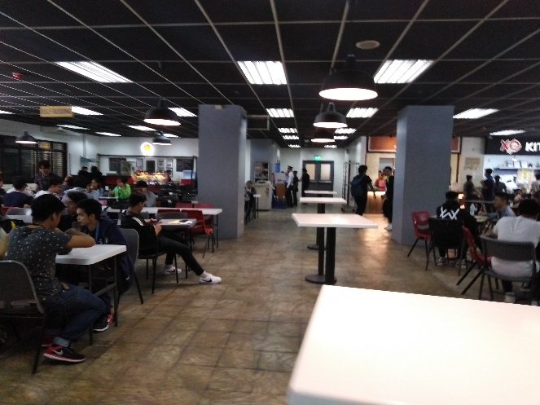
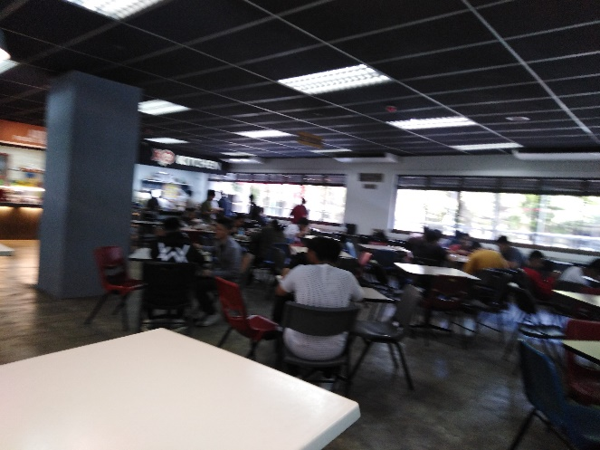
documentation:

Slide 13
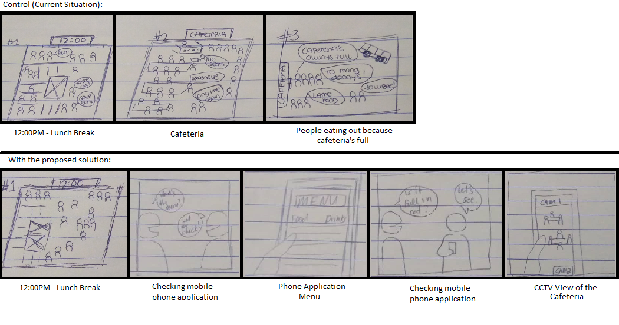
Storyboards:

Slide 14
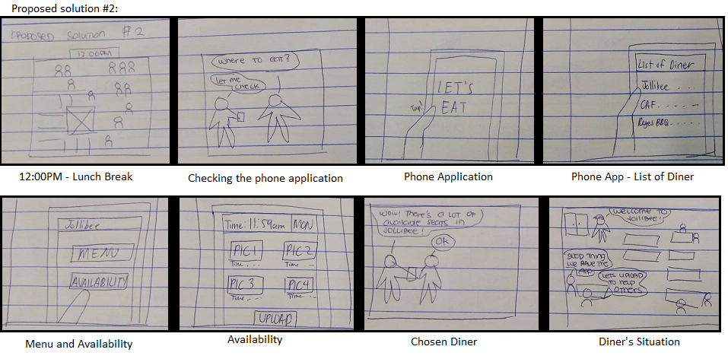
Storyboards:

Slide 15
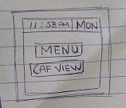
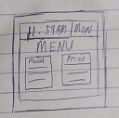
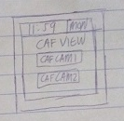
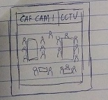
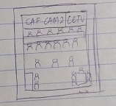
Prototype#1

Slide 16
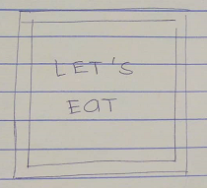
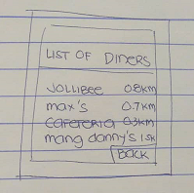
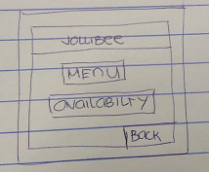
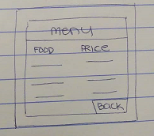
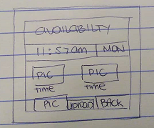
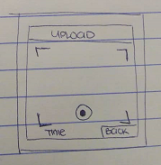
Prototype#2

Slide 17
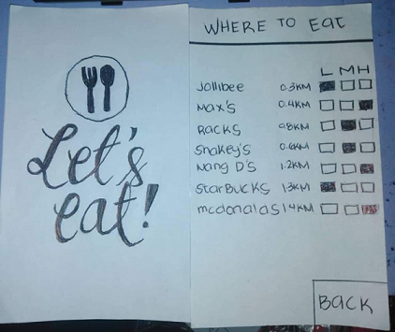
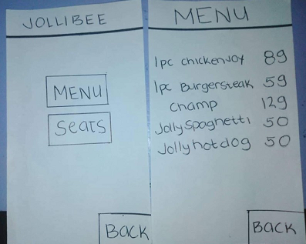
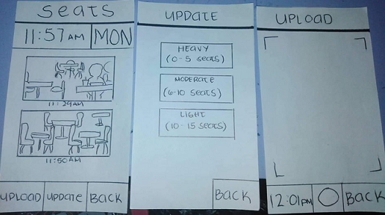
Prototype#3

Slide 18
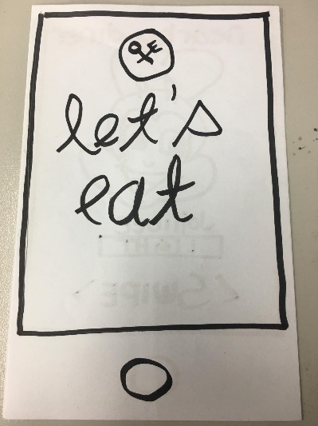
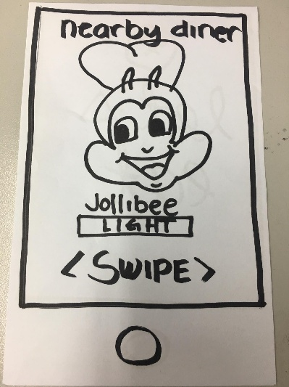
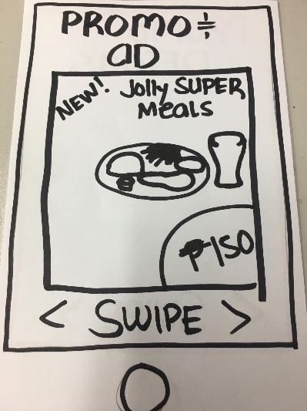
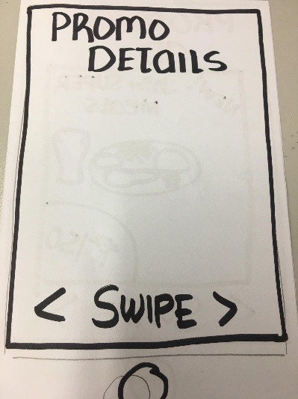
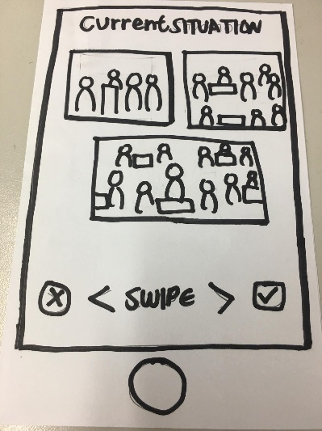
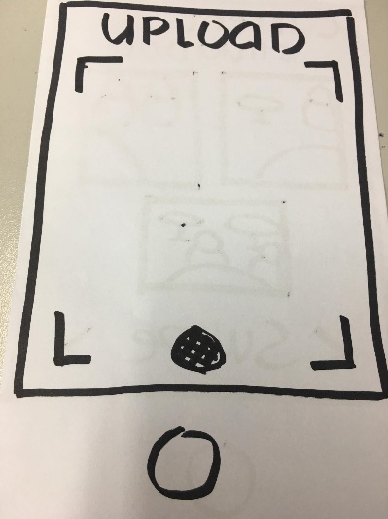
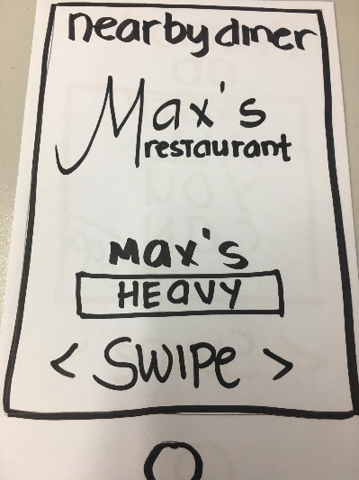
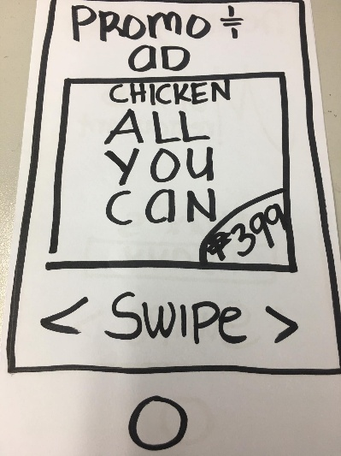
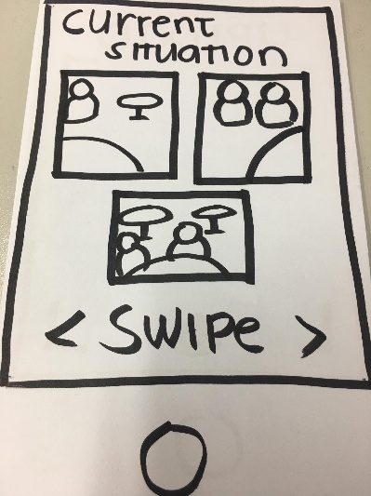
Prototype#4

Slide 19
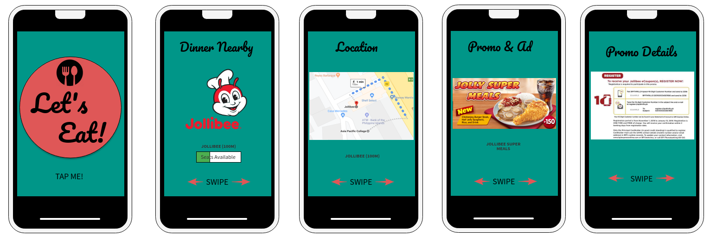
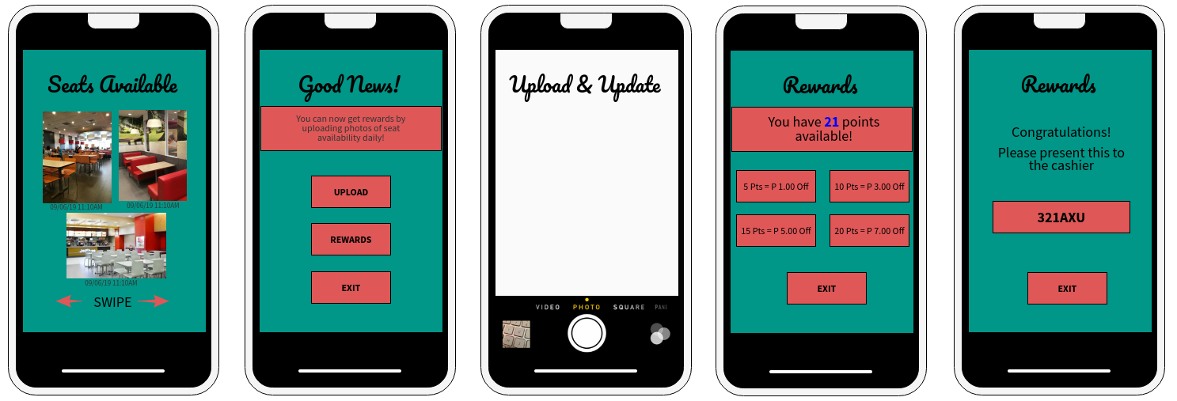
DIGITAL MOCK

Slide 20
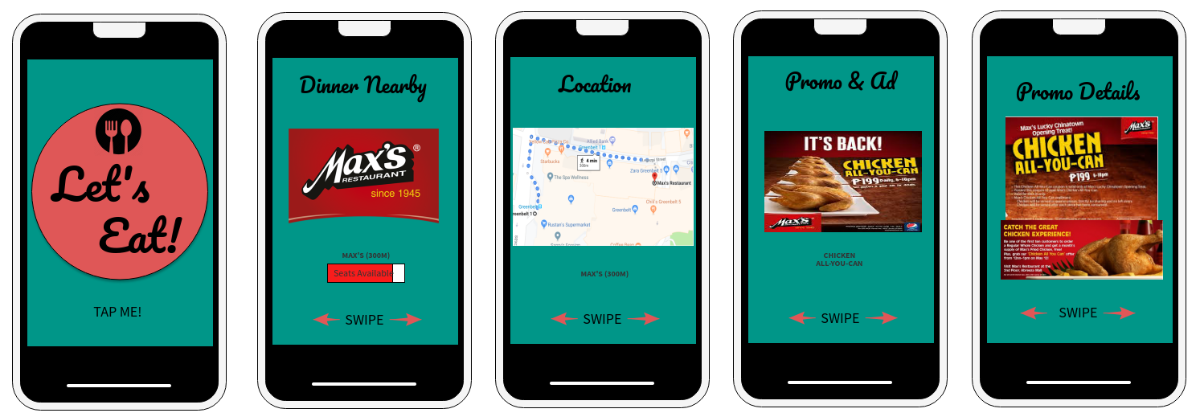
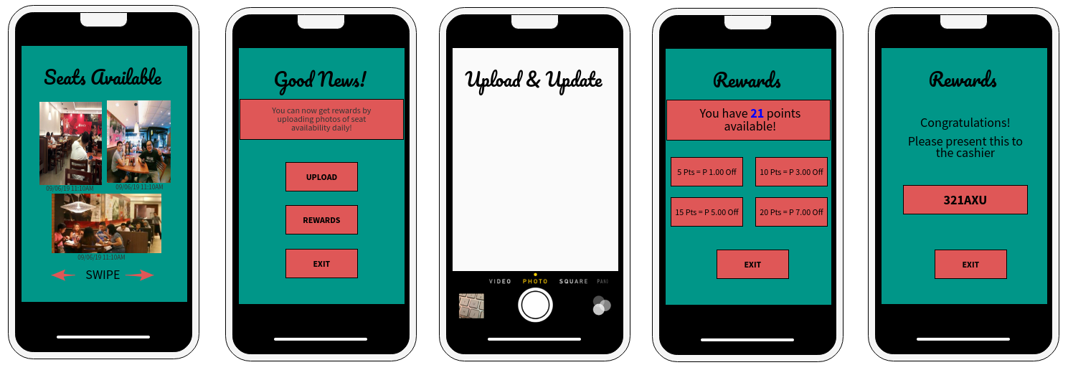
DIGITAL MOCK

Slide 21
TRANSCRIPT (Feedback):
INTERVIEW#1: (Paper Prototype)
“Convenient. Kasi yong UI niya parang “TINDER” lang swipe right kapag gusto mo, swipe left kapag ayaw mo. So Okay yon, at saka nakalagay doon yong promo ano yong mga meron saka nakikita mo yong seat placements. Kaya okay siya sakin”
– Jasfer Casibang
INTERVIEW#2: (Paper Prototype)
“Swipe on the bottom side is a little redundant but I understand why it’s there, for further instructions. But overall I like the idea and its UI is very simple and it also suggests the nearest restaurant available which is nice”
– Monique Aranzanso

Slide 22
TRANSCRIPT (Feedback):
INTERVIEW#1: (DIGITAL MOCKUP)
“Okay yung makikita mo yung seats, tapos may rewarding system”
– Ralph Dedumo
INTERVIEW#2: (DIGITAL MOCKUP)
“Maganda naman yung app, simple lang yung design kaya gusto ko siya”
– Neil Ochotorena
INTERVIEW#3: (DIGITAL MOCKUP)
“The design is neat, appealing and not too complicated. There wasn’t any problem in the app”
– Jep Ramos

Slide 23
Feedback take aways:
Convenient
Simple and appealing
UI is user-friendly
Good additions: Promo inclusions, Seat availability, Suggests nearest restaurants and Rewarding system.

Slide 24
Video references: Paper Prototype
https://www.youtube.com/watch?v=g4hGXjYXlYI&feature=youtu.be&fbclid=IwAR38e2U-cNO5d2vUHN7wOEUz0ln6IrjtFMGr1cEQM90Z-fsaQGeJBF7fStw
https://www.youtube.com/watch?v=rIkB1o9cJpM&feature=youtu.be&fbclid=IwAR3-rl3Ku8WJxcPf2vgCtQV4EOSdUglzFfm9rx10ebHtQV1lAz3pD9zs07U https://www.youtube.com/watch?v=4ZxhoH9TzOU
https://www.youtube.com/watch?v=HOL_8-IFd3w
https://www.youtube.com/watch?v=oVHEFGyrwgI

Slide 25
Video references: DIGITAL MOCKUP
https://www.youtube.com/watch?v=X-IrxadgViA

